Slide 1




</coding>
Gavin McClary
Senior Lecturer

Slide 2

Why are you here?
Q Why did you decide to take this course?
Q What do you hope to get out of the course?
Q How did you find out about the course?

Slide 3
FACEBOOK
YOUR SITE

Slide 4
What would you rather do?

Slide 5
What will you learn?
Where and how code is used in the real world
What coding languages are available and what they are used for
How to use the Python programming language
You will get to know some common, foundation level concepts that apply in most programming language
Some common coding concepts such as:
Input
Output
Variables
Data Types
Dealing with errors

Slide 6
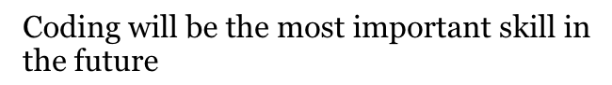

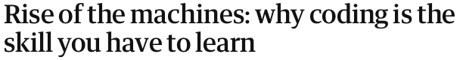

Why should you learn?

Slide 7
Code in the real world

Slide 8


What is a coding language?
There are many different coding languages out there and they are designed to be used for different purposes such as:
Website development
Creating desktop software e.g. Word, Excel and PowerPoint
Solving scientific problems
Analysing data
Mobile phone apps
Games
And many, many more…

Slide 9

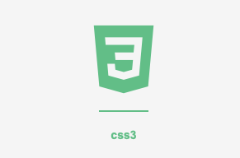
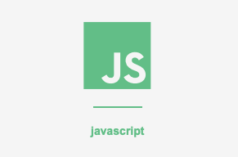
Languages: Web Development
Work Packages:
HTML – Hyper Text Markup Language
Describes the structure and
presentation of information on a web page
CSS – Cascading Style Sheets
Colours, layout, and fonts of a web page
JavaScript
Used mostly for user interaction
e.g. buttons and menus

Slide 10
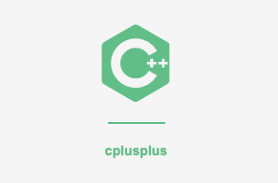
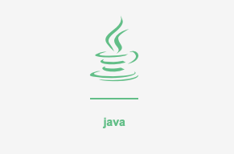
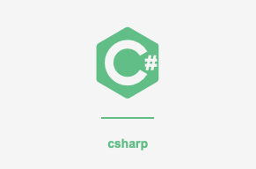
Languages: Desktop Software
C++
Microsoft Windows Operating System
Java
Official language for Android development
C#
Enterprise applications

Slide 11
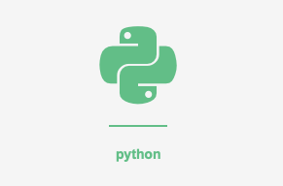
Languages: Scientific Problems and Analysing Data
Python
Popular in Data Science, AI and Machine Learning
Also, widely taught in schools due to its readability
Can be used for web development and many more uses…

Slide 12
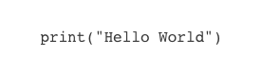
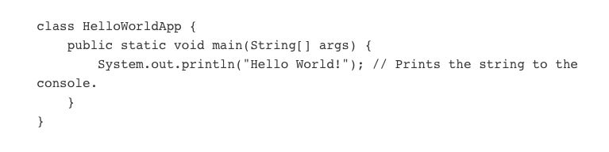
Why Python?
As stated previously it is easy to read…
Python
Java

Slide 13
Shall we get started?

Slide 14
If you don’t have Python installed use this…
https://repl.it

Slide 15
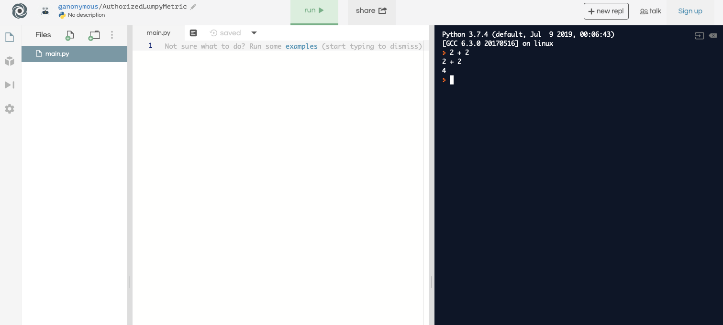
This is how we run programs created in window
1
1
2
This is where we will create programs with more than one line of code
This is where we will type our commands. Pressing enter will give results of command.

Slide 16
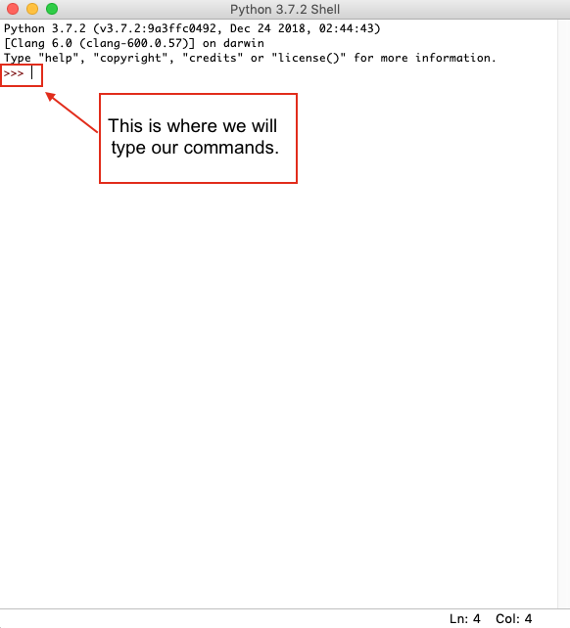
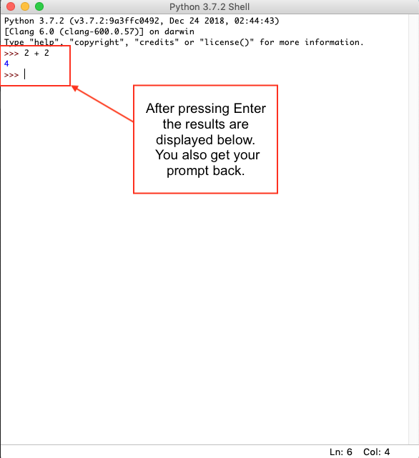
If you do have Python installed…

Slide 17
Common Concepts
Input
Output
Variables
Data Types
Errors
Sequencing of commands
Syntax

Slide 18
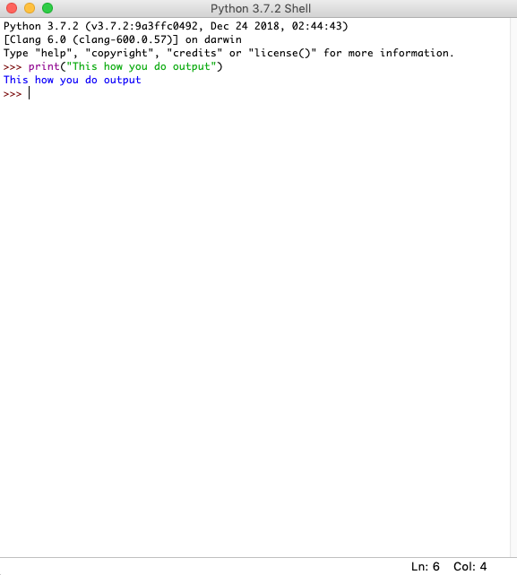
Output
If we want to display information on screen in Python we use the “Print” function.
The computer is “dumb”. If you want it to print some output you have to tell it explicitly.
Unless it’s an error (you’ll find this out quick no doubt!)

Slide 19
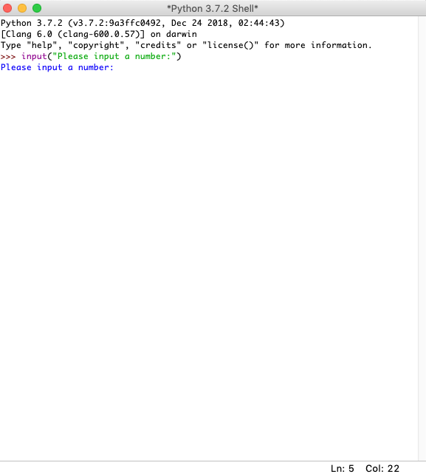
Input
If we want to gather information from the keyboard into Python we use the “Input” function.
The computer is “dumb”. If you want it to gather some information you have to explicitly tell it.

Slide 20
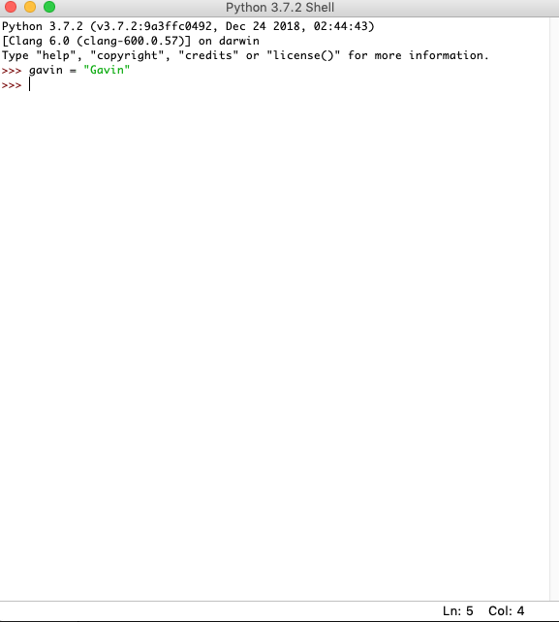
Variables: Declaring
Variables are SUPER useful in coding.
They are used to store information somewhere for later use.
The computer is DUMB. Unless you tell it to store the information you give it somewhere, guess what it won’t!

Slide 21
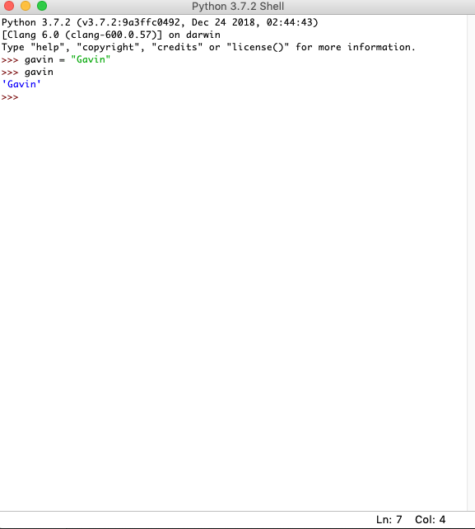
Variables: Retrieving
If we want to access the contents of a variable later we refer to the variable name.
We won’t always be printing the variable contents

Slide 22
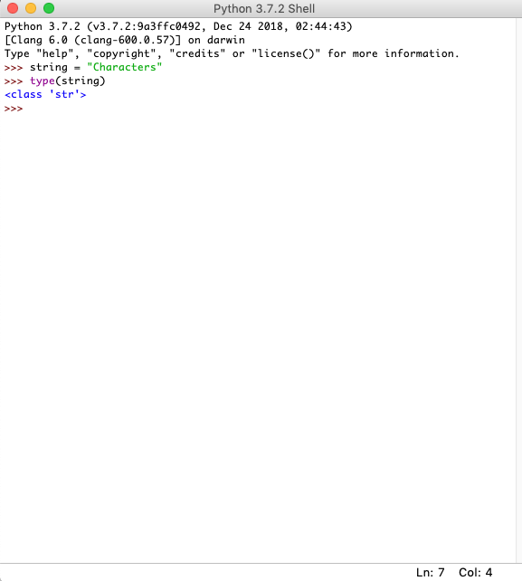
Data Types: String
Data Types are another SUPER useful and commonly used concept in coding.
I’ll show you 4 data types today but there are many more.
First up is the String data type.
A String is just a string of characters.
So here we are declaring a variable of type str (short for string).
(You don’t have to name the variable “string” btw!)

Slide 23
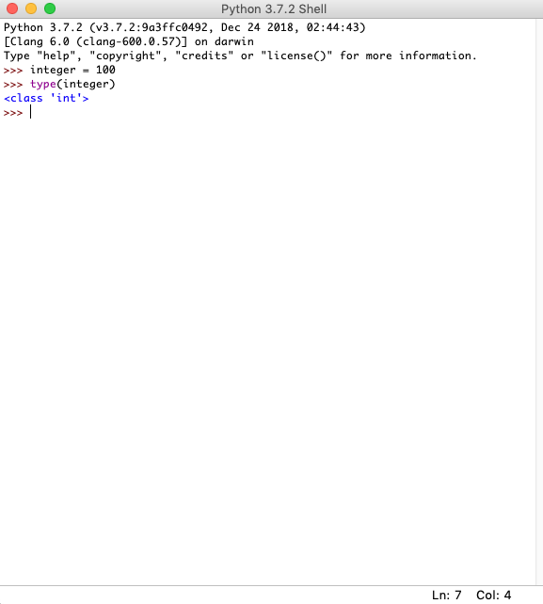
Data Types: Integer
Next we have the Integer data type.
An Integer is just a whole number e.g. 1, 2, 10, 100, 1000
So here we are declaring a variable of type int (short for integer)

Slide 24
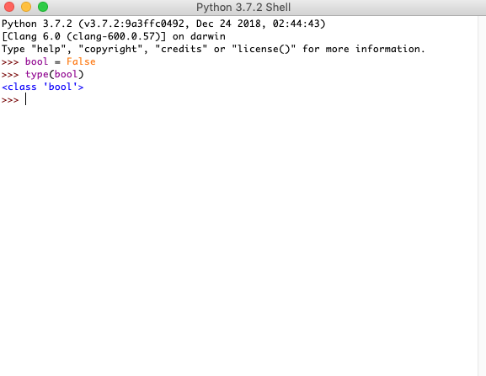
Data Types: Boolean
Finally (for today) we have the Boolean data type.
A Boolean either True or False and nothing else!
So here we are declaring a variable of type bool (short for Boolean)

Slide 25
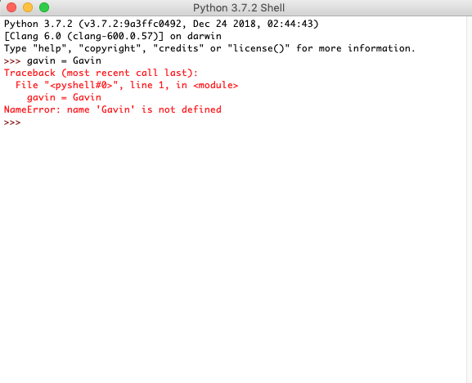
Dealing with Errors
Errors are annoying!
Errors are frustrating!
Errors are common!
You’ll get used to them ☺
Here we have two common errors you might experience today.
My name will not be in your error!
READ the errors and THINK! What could be causing it?

Slide 26
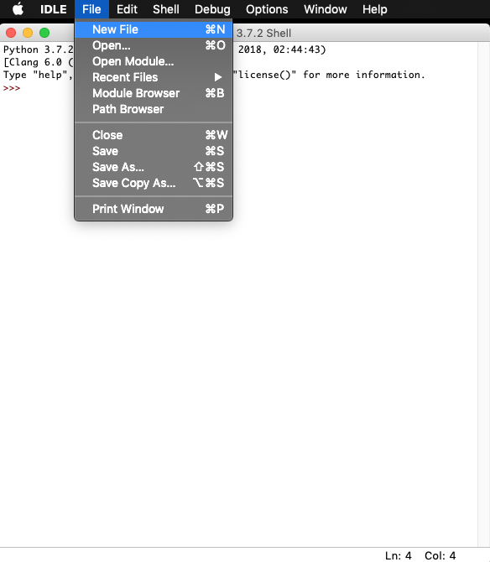
Creating Programs
Once you have tried some code out in the Shell you will want to be able to write your first program.
In the IDLE menu above the Shell window click on “File” the “New File”.

Slide 27
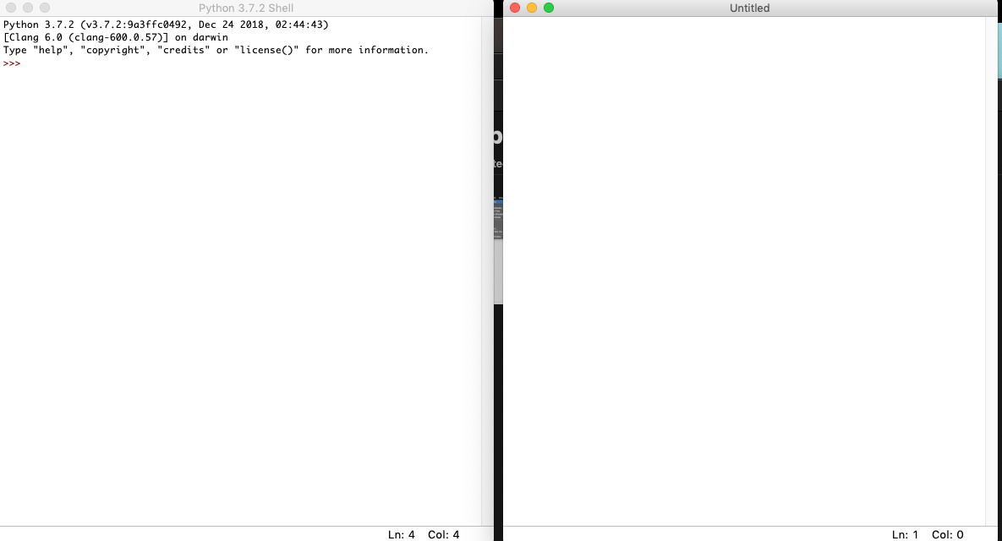
Creating Programs
Your program code
will go here

Slide 28
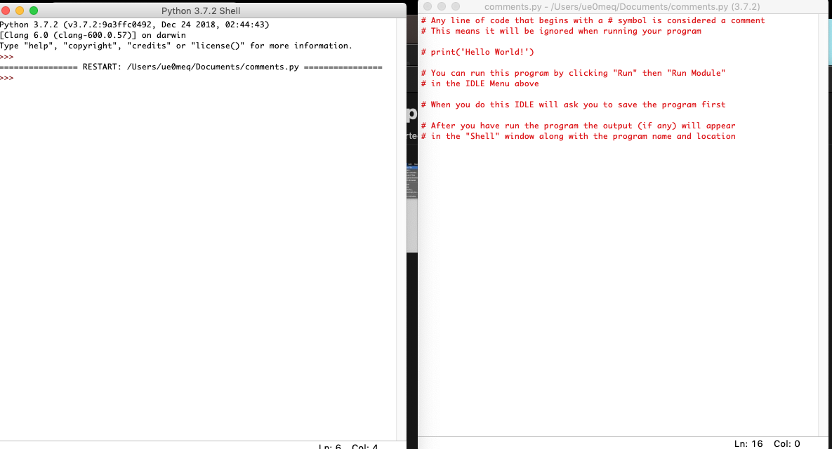
Running the Program

Slide 29
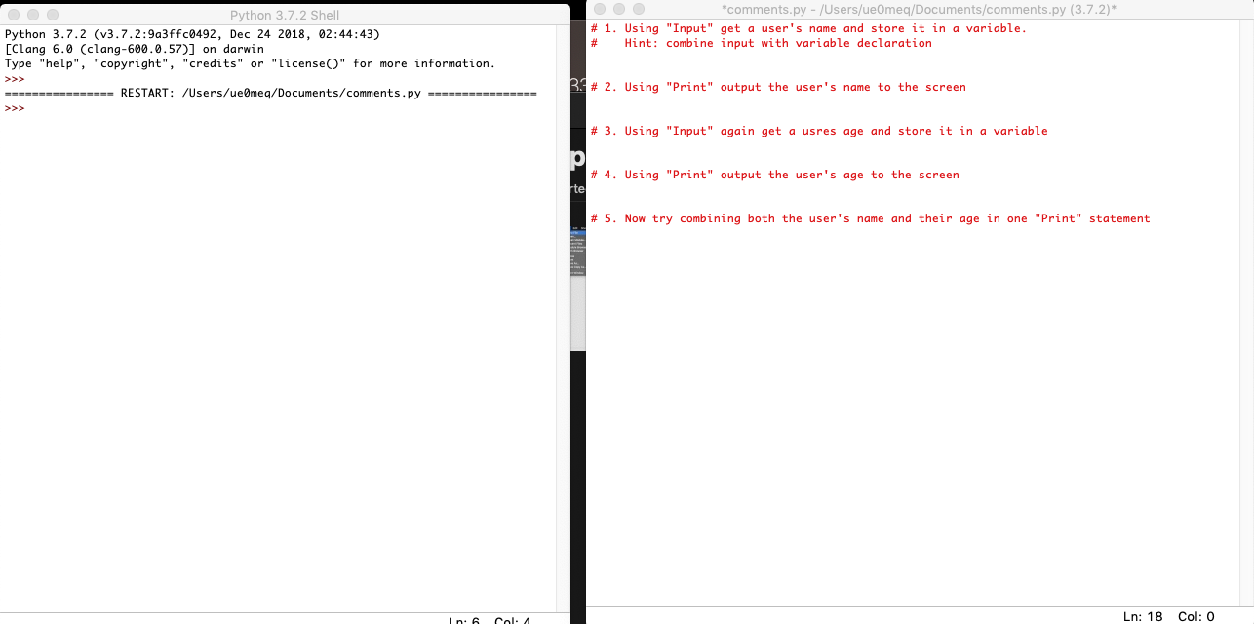
Challenge

Slide 30
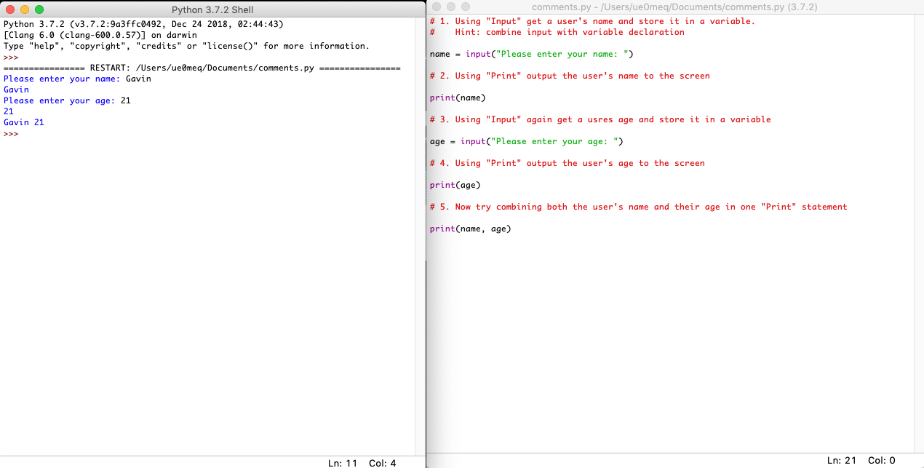
Challenge: Answers

Slide 31
Extra Challenge: Basic calculator
Requirements
Must include code comments
Must accept user input (include a prompt)
Must store input in a variable
Must be able to accept whole numbers e.g. (21,100,1000)
Must be able to add two whole numbers together
Must be able to print the sum of the two numbers that were input
Must include a message along with the sum of the numbers e.g. “The sum of x plus x is: y”

Slide 32
Extra Extra Challenge: Password checker
Requirements
Must be commented (both single line comments and multi-line comments)
Must accept user name as input (include a prompt)
Must accept password as input (include a prompt)
Must use if condition to check if password is correct
If password is correct print out something e.g. “Password is correct!”
If password is incorrect print out something e.g. “Password is incorrect!”

Slide 33
What have you learned?
Where and how code is used in the real world
What coding languages are available and what they are used for
How to use the Python programming language
You will get to know some common, foundation level concepts that apply in most programming language
Some common coding concepts such as:
Input
Output
Variables
Data Types
Dealing with errors

Slide 34

Digital Badges
All of the Coding 101/102/103 courses come with a Digital Badge which confirms attendance and contains information on the subjects studied today.
You will receive an email shortly asking you to register if you want to receive your badge.
If you do not want to receive a badge then please ignore/delete the email.

Slide 35

Next Steps
Coding102 – Part 2 (of course!)
Free online resources:
www.codeacademy.com
www.sololearn.com
https://realpython.com
https://automatetheboringstuff.com

Slide 36

Your feedback

